Slide 1
Unit 3: Queue

Slide 2
CONTENTS
Introduction
Queue as an ADT
Primitive Operations in Queue
Linear and Circular Queue and Their Application
En-queue and De-queue
Priority Queue.

Slide 3

Introduction
It is an ADT similar to stack but is open in both end
One end is used to insert element while another end is used to delete
It follows First In First Out principle (FIFO)

Slide 4
Queue
A Queue is an ordered collection of items from which items may be deleted at one end (called the front of the queue) and into which items may be inserted at the other end (the rear of the queue).
Enqueue
Dequeue
rear
Front
Figure: Queue

Slide 5
Queue can be represented in various ways. One of the way is to use array
Queue uses two variables Front and Rear are used to represent first and the last element
If N is the size of a queue
FRONT= NULL represents the queue is empty
REAR= N-1 represents the queue is full

Slide 6
Operations on queue:
MakeEmpty(q): To make q as an empty queue
Enqueue(q, x): To insert an item x at the rear of the queue
Dequeue(q): To delete an item from the front of the queue q
IsFull(q): To check whether the queue q is full
IsEmpty(q): To check whether the queue q is empty
Traverse (q): To read entire queue i.e. display the content of the queue

Slide 7
Initialization of queue:
The queue is initialized by having the rear set to -1, and front set to -1. Let us assume that maximum number of the element we have in a queue is N
Item N-1
.
.
.
Item 1
Item 0
Front=-1
Rear = -1

Slide 8






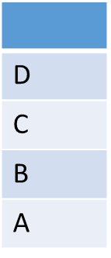
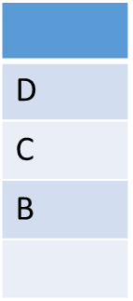
Dequeue
D
C
Enqueue (A)
Enqueue (B)
Enqueue (C)
Enqueue (D)
Dequeue (A)
Dequeue (B)
Front= 0
Rear= 0
Front= 0
Rear= 1
Front= 0
Rear= 2
Front= 0
Rear= 3
Front= 1
Rear= 3
Front= 2
Rear= 3

Slide 9
Applications of queue
Task waiting for the printing
Time sharing system for use of CPU
For access to disk storage
Task scheduling in operating system
In real life scenario, call center phone system uses queue
In media player etc

Slide 10
The Queue as an ADT:
A queue q of type T is a finite sequence of elements with the operations
MakeEmpty(q): To make q as an empty queue
IsEmpty(q): To check whether the queue q is empty. Return true if q is empty and return false otherwise.
IsFull(q): To check whether the queue q is full. Return true in q is full, return false otherwise.
Enqueue(q, x): To insert an item x at the rear of the queue, if and only if q is not full.
Dequeue(q): To delete an item from the front of the queue q. if and only if q is not empty.
Traverse (q): To read entire queue that is display the content of the queue.

Slide 11
Implementation of queue
Queue can be implemented in the following two ways
Array Implementation (Static Implementation)
Linked list implementation (Dynamic implementation)

Slide 12
Array implementation of queue
In array implementation the array is used to store data element
Types of queue
Liner queue
Circular queue
Priority queue

Slide 13
Linear queue
By default the queue that we leaned is linear queue
Structure of Linear queue
#define MAXSIZE 10
struct queue
{
int front;
int rear;
int items[MAXSIZE];
};
typedef struct queue qt;

Slide 14
Algorithm to insert an item in queue:
if rear>=MAXSIZE-1
print “queue overflow” and return
else
set rear=rear+1
item[rear]=newitem
4. end

Slide 15
Algorithm to delete an element from the queue:
if rear<-1
print “queue is empty” and return
else
deleted_item=item[front];
front=front+1;
2. end

Slide 16
Operations of linear queue:
The MakeEmpty function:
void makeEmpty(qt *q)
{
q->rear=-1;
q->front=-1;
}
The IsEmpty function:
int IsEmpty(qt *q)
{
if(q->rear =-1)
return 1;
else
return 0;
}

Slide 17
The Isfull function:
int IsFull(qt *q)
{
if(q->rear == MAXSIZE-1)
return 1;
else
return 0;
}

Slide 18
The Enqueue function:
void Enqueue(qt *q, int newitem)
{
if(IsFull(q))
{
printf(“queue is full”);
exit(1);
}
else
{
q->rear++;
q->items[q->rear]=newitem;
}
}

Slide 19
The Dequeue function:
int Dequeue(qt *q)
{
if(IsEmpty(q))
{
printf(“queue is Empty”);
exit(1);
}
else
{
return(q->items[q->front]);
q->front++;
}

Slide 20
Problems with Linear queue implementation:
Both rear and front indices are increased but never decreased. As items are removed from the queue, the storage space at the beginning of the array is discarded and never used again. Wastage of the space is the main problem.
For example
This queue is considered full, even though the space at beginning is vacant
10 | 20 | 30 | 40 | 50 | 60 | 70
Front
Rear

Slide 21
Circular Queue

Slide 22
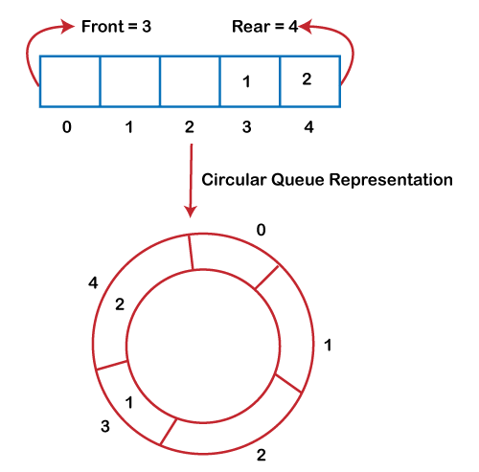
What is circular queue?
Circular queue is the one where the insertion is done at the very first location of the queue if the last location of the queue is full.
It overcomes the problem of the space unutilized in the linear queue

Slide 23
Declaration of circular queue
Declaration of a Circular Queue:
# define MAXSIZE 50 /* size of the circular queue items*/
struct cqueue
{
int front;
int rear;
int items[MAXSIZE];
};
typedef struct cqueue cq;

Slide 24
Algorithm to insert new element
This algorithm is assume that rear and front are initially set to -1.
if (front==(rear+1)%MAXSIZE)
print Queue is full and exit
Else
rear=(rear+1)%MAXSIZE; [increment rear by 1
cqueue[rear]=item;
end

Slide 25
Algorithms for deleting an element
if (rear==front==-1) [checking empty condition]
print Queue is empty and exit
2. item=cqueue[front];
3.front=(front+1)%MAXSIZE; [increment front by 1]
4. return item;
5. end.

Slide 26
Declaration of a Circular Queue:
define MAXSIZE 50 /* size of the circular queue items*/
struct cqueue
{
int front;
int rear;
int items[MAXSIZE];
};
typedef struct cqueue cq;

Slide 27
Operations of a circular queue
The MakeEmpty function:
void makeEmpty(cq *q)
{
q->rear=-1;
q->front=-1;
}

Slide 28
The IsEmpty function:
int IsEmpty(cq *q)
{
if(q->rear < q->front)
return 1;
else
return 0;
}

Slide 29
The Isfull function:
int IsFull(cq *q)
{
if(q->front==(q->rear+1)%MAXDIZE)
return 1;
else
return 0;

Slide 30
The Enqueue function:
void Enqueue(cq *q, int newitem)
{
if(IsFull(q))
{
printf(“queue is full”);
exit();
}
else
{
q->rear=(q->rear+1)%MAXDIZE;
q->items[q->rear]=newitem;
}
}

Slide 31
The Dequeue function:
int Dequeue(cq *q)
{
if(IsEmpty(q))
{
printf(“queue is Empty”);
exit();
} else
{
q->front=(q->front+1)%MAXSIZE;
return(q->items[q->front]);

Slide 32
Priority queue

Slide 33
Priority queue
A priority queue is a collection of elements such that each element has been assigned a priority and the order in which elements are deleted and processed comes from the following rules:
An element of higher priority is processed before any element of lower priority.
If two elements has same priority then they are processed according to the order in which they were added to the queue.
The best application of priority queue is observed in CPU scheduling.
The jobs which have higher priority are processed first. If the priority of two jobs is same this jobs are processed according to their position in queue.
A short job is given higher priority over the longer one

Slide 34
THANK YOU

